Slide 1
Introduction to Trees
Course Code: 00090
Course Title: Discrete Mathematics
Dept. of Computer Science
Faculty of Science and Technology
Lecturer No: | 20 | Week No: | 11 | Semester:
Lecturer: | Name & email

Slide 2
Lecture Outline
Introduction of Tree
Quiz-3 today

Slide 3
Objectives and Outcomes
Objectives: To understand the definition of tree and different tree terminologies, to understand the theorems related to tree.
Outcomes: The students are expected to be able to explain tree terminologies and the theorems related to tree.
ter this class the student will be able to define different kind Tree. The student will be capable of demonstrating theorem related to Tree. Finally, by using the theorem the student will be able to sort out mathematical problems linked with Tree.

Slide 4
What is a Tree?
Definition: A tree is a connected undirected graph with no simple circuits.

Slide 5
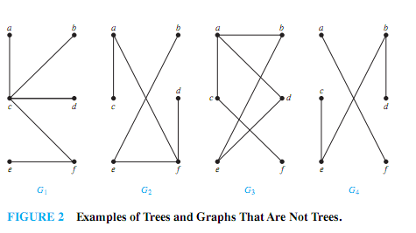
Example 1
Which of the graphs shown in Figure 2 are trees?

Slide 6
Example 1
Solution:
G1 and G2 are trees, because both are connected
graphs with no simple circuits.
G3 is not a tree because e, b, a, d, e is a simple circuit in this graph.
Finally, G4 is not a tree because it is not connected.

Slide 7
Theorem 1
An undirected graph is a tree if and only if there is a unique simple path between any two of its vertices.

Slide 8
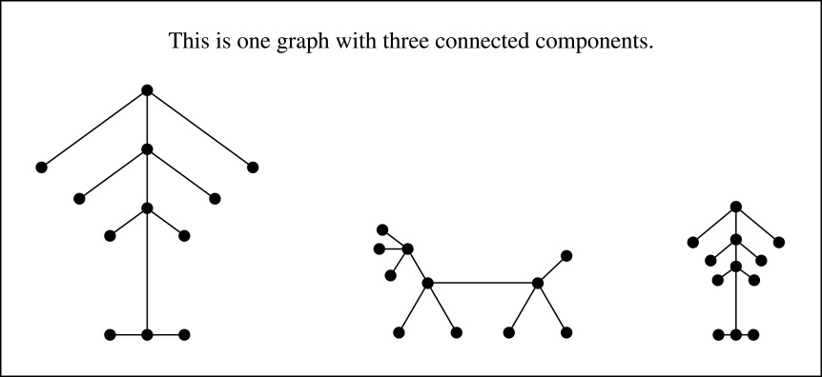
Forest
A forest is a graph that has no simple circuit, but is not connected. Each of the connected components in a forest is a tree.

Slide 9
Rooted Tree
Rooted tree: A rooted tree is a tree in which one vertex has been designated as the root and every edge is directed away from the root.
We can change an unrooted tree into a rooted tree by choosing any vertex as the root
Different choices of the root produce different rooted trees

Slide 10
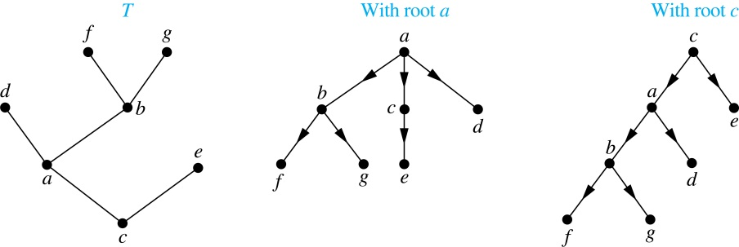
A Tree and Rooted Trees Formed by Designating Two Roots
The rooted trees formed by designating a to be root and c to be the root

Slide 11
Ordered Rooted Tree
Definition: An ordered rooted tree is a rooted tree where the children of each internal vertex are ordered.
We draw ordered rooted trees so that the children of each internal vertex are shown in order from left to right
Definition: A binary tree is an ordered rooted where each internal vertex has at most two children. If an internal vertex of a binary tree has two children, the first is called the left child and the second the right child. The tree rooted at the left child of a vertex is called the left subtree of this vertex, and the tree rooted at the right child of a vertex is called the right subtree of this vertex.

Slide 12
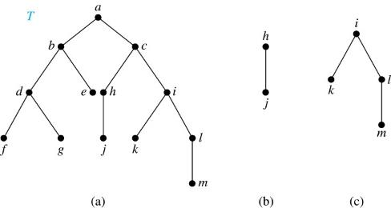
Example 4 @page 627
Consider the binary tree T.
(i) What are the left and right children of d?
(ii) What are the left and right subtrees of c?
Solution:
(i) The left child of d is f and the right child is g.
(ii) The left and right subtrees of c are displayed in
(b) and (c).

Slide 13
Rooted Tree Terminologies
Parent: If v is a vertex of a rooted tree other than the root, the parent of v is the unique vertex u such that there is a directed edge from u to v.
Note that such a vertex is unique
Child: When u is a parent of v, v is called a child of u.
Siblings: Vertices with the same parent are called siblings.
Leaf: A vertex of a rooted tree is called a leaf if it has no children.
Internal vertex: A vertex that has children is called internal vertex.
Note: The root is an internal vertex unless it is the only vertex in the graph, in which case it is a leaf.

Slide 14
Rooted Tree Terminologies
Ancestor(s): The ancestors of a vertex other than the root are the vertices in the path from the root to this vertex, excluding the vertex itself and including the root.
Descendant(s) : The descendants of a vertex v are those vertices that have v as an ancestor.
Subtree: If a is a vertex in a tree, the subtree with a as its root is the subgraph of the tree consisting of a and its descendants and all edges incident to these descendants.

Slide 15
Illustration of Tree Terminology
Root
Level 0
R
Level 1
S
T
Internal Vertex
Level 2
X
U
V
W
Leaf
Level 3
Y
Z
Siblings
Child of X
Subtree rooted at S
Parent of Z and Y

Slide 16
Illustration of Tree Terminology
root
a
internal vertex
parent of g & f
b
c
child of c
d
e
f
g
leaf
siblings
h
i
16

Slide 17
Books
Rosen, K. H., & Krithivasan, K. (2012). Discrete mathematics and its applications: with combinatorics and graph theory. Tata McGraw-Hill Education. (7th Edition)

Slide 18
References
Discrete Mathematics, Richard Johnsonbaugh, Pearson education, Inc.
Discrete Mathematical Structures, Bernard Kolman, Robert C. Busby, Sharon Ross, Prentice-Hall, Inc.
SCHAUM’S outlines Discrete Mathematics(2nd edition), by Seymour Lipschutz, Marc Lipson
University of Wisconsin-Madison
http://pages.cs.wisc.edu/~deppeler/cs367-common/readings/Trees/intro.html
Bradfield School of Computer Science
https://bradfieldcs.com/algos/trees/introduction/

